Slide 1
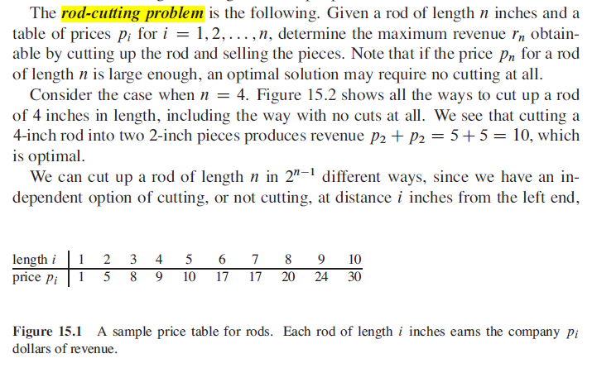


Slide 2

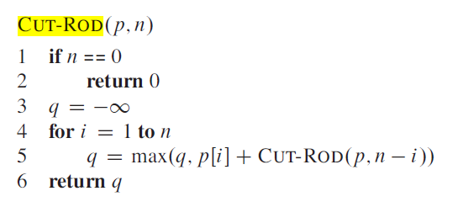
Rod-cutting, recursive solution

Slide 3
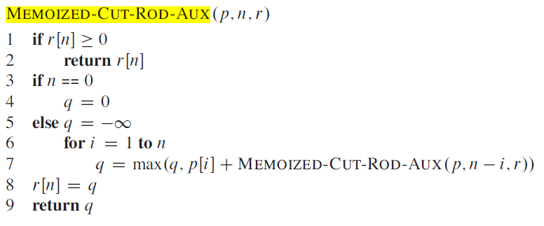
Top-down with memoization

Slide 4
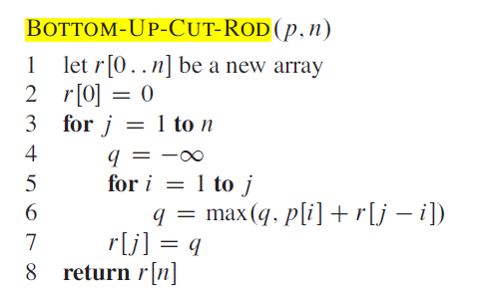
Or build solution bottom-up

Slide 5
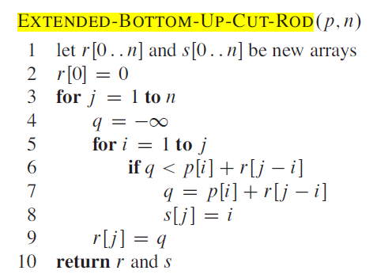

S[j] , the optimal size of the first piece to cut off

